Slide 1
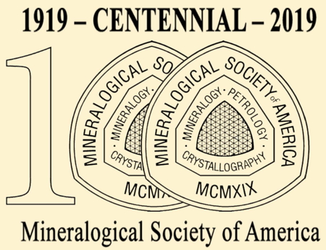
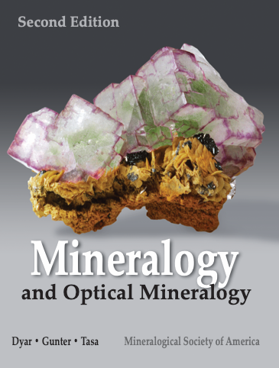
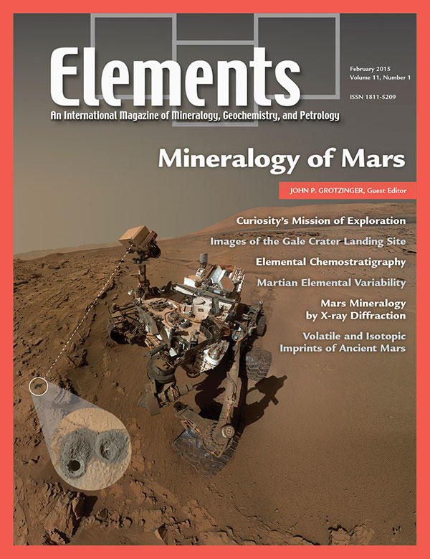
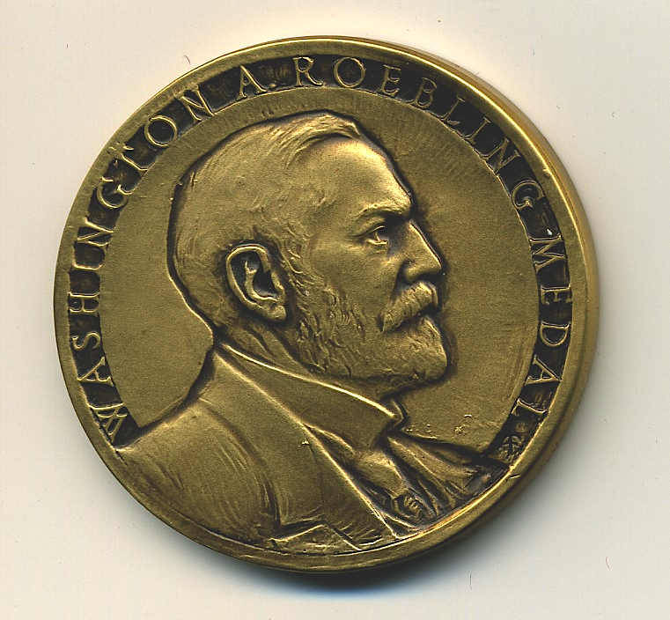
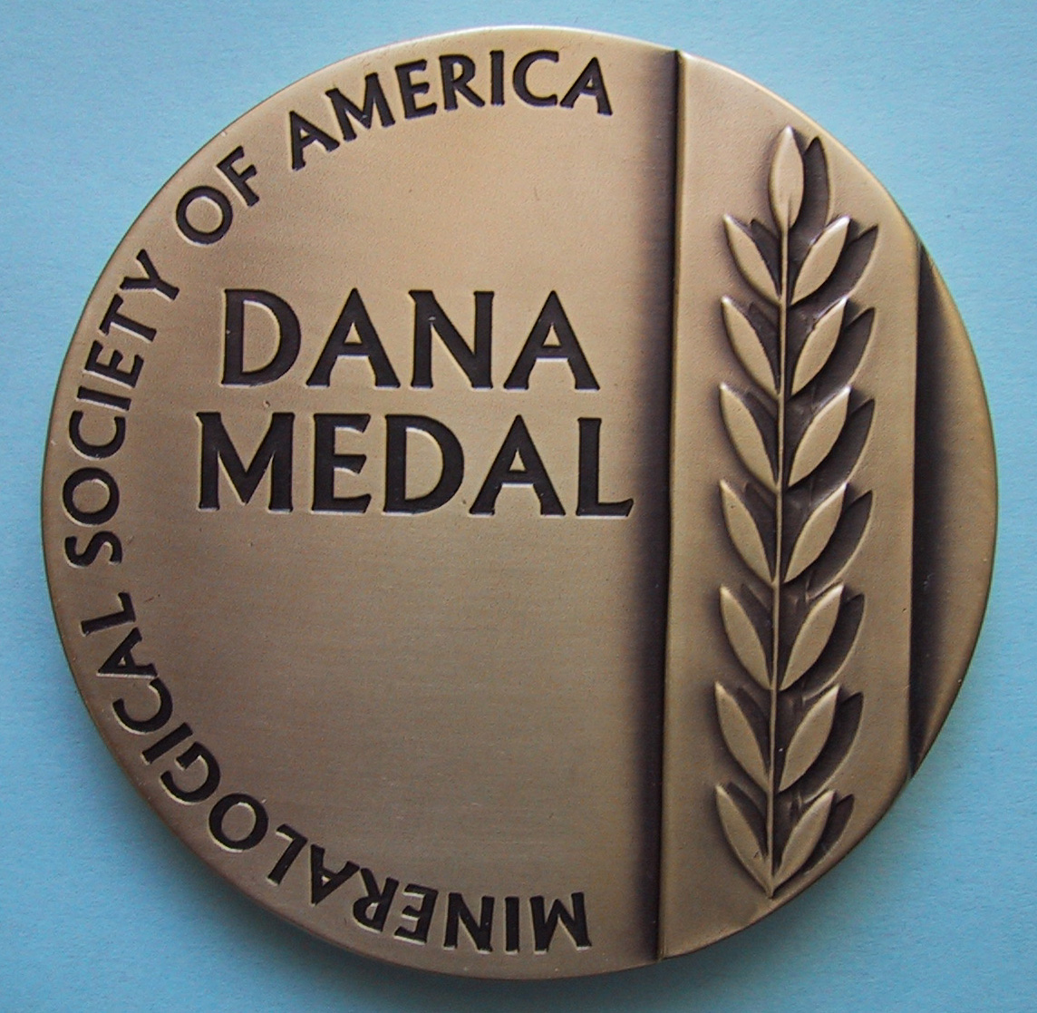
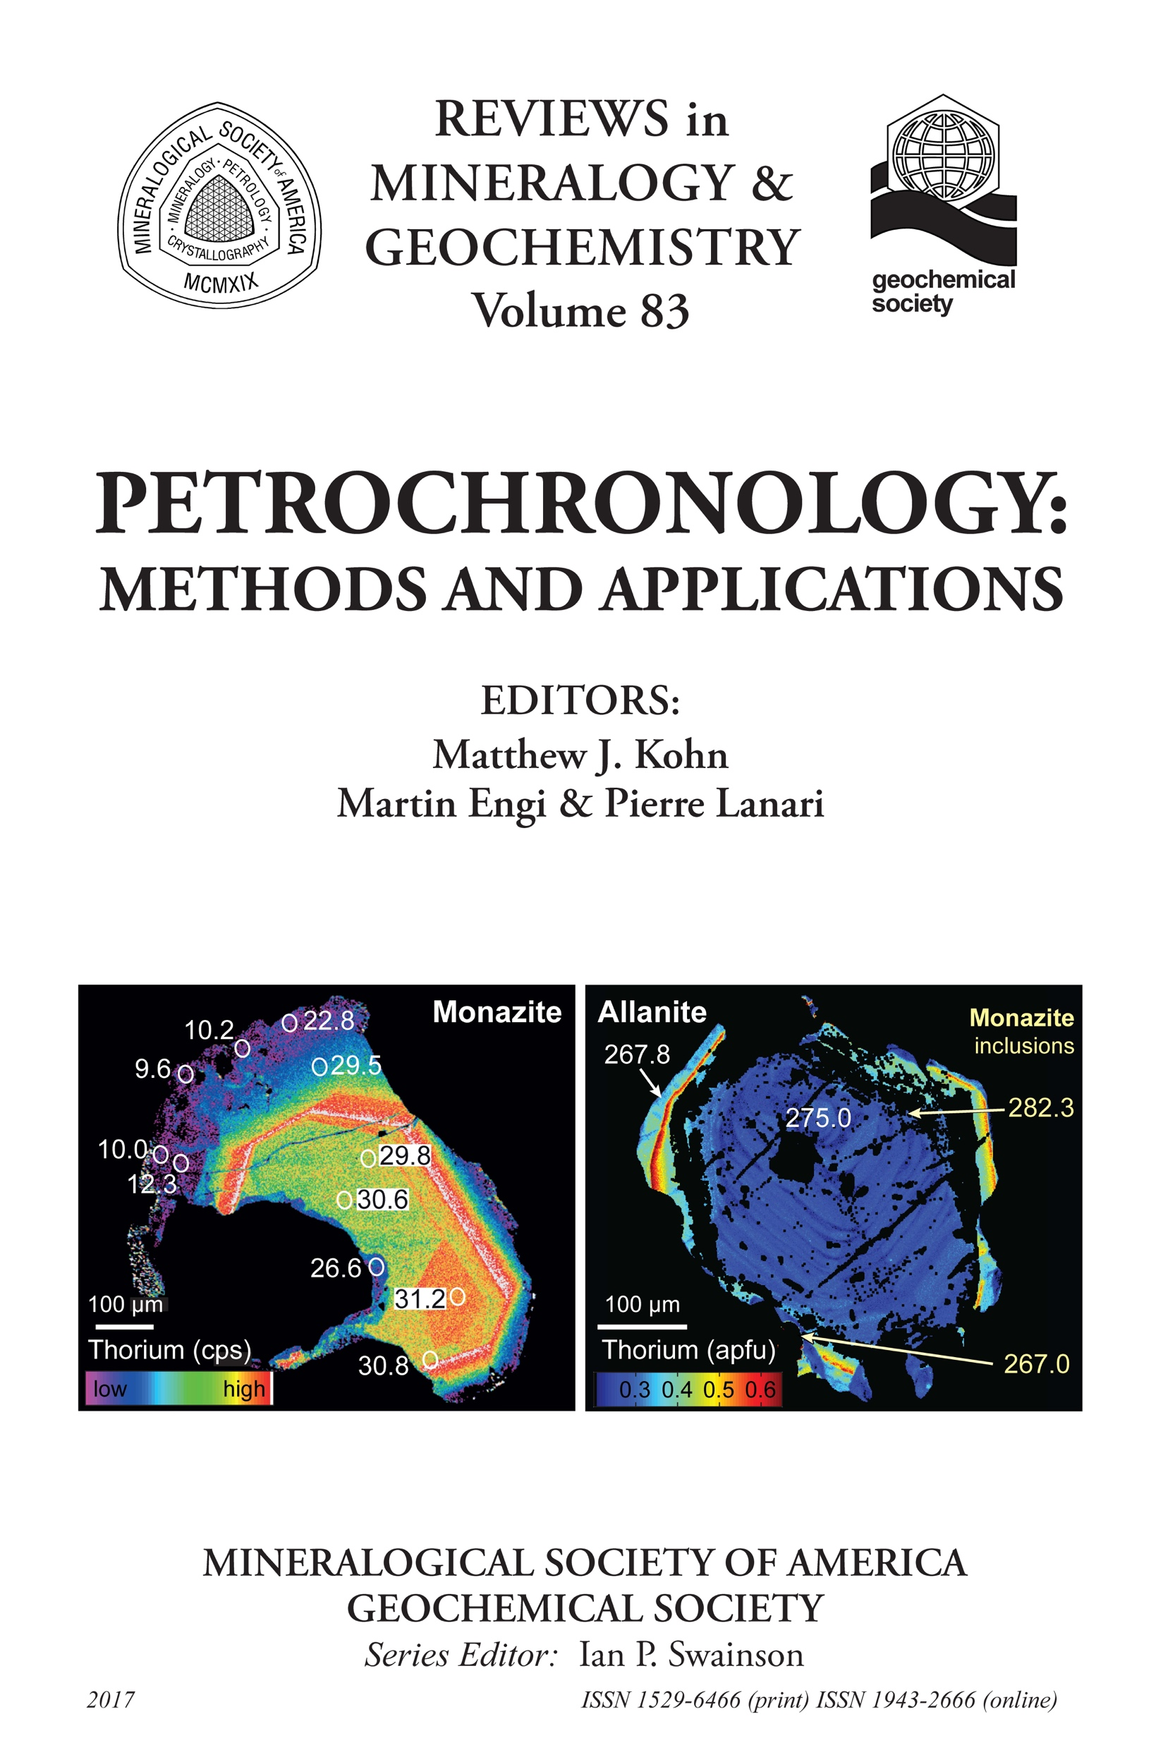
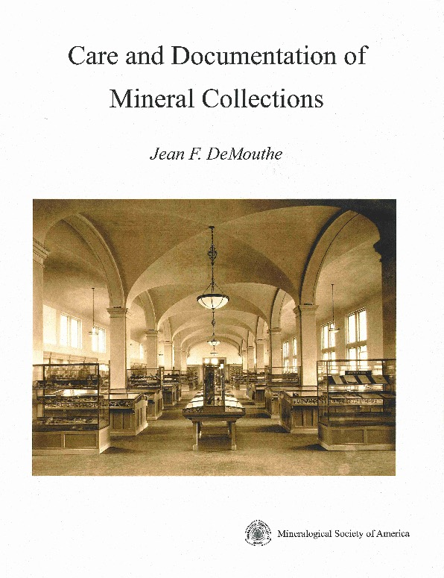
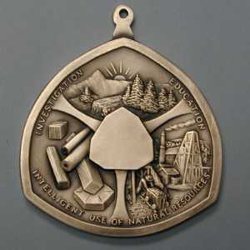
Mineralogical Society of America
First-rate (and inexpensive) Publications
Programs and Services
Publications: American Mineralogist, Elements, Reviews, and more.
Communications: MSA-Talk list-serv
Education: MSA Distinguished Lectureship Program, Mineralogy for Kids, Short courses, workshops
Awards: MSA Undergraduate Prize, Achievement awards
Grants: For research in crystallography, mineralogy and petrology
Discounts: On publications and registration at GSA, AGU and North American Goldschmidt
www.minsocam.org

